Slide 1
COVID-19 AWARENESS
COVID-19: Caused by a virus known as Severe Acute Respiratory Syndrome Coronavirus-2 (SARS-CoV-2). Spreads very easily from person to person.
Signs and symptoms: Fever or chills, cough, difficulty in breathing, cold, headache, diarrhea, loss of taste/smell, and several non-specific symptoms.
Transmission: Respiratory droplets, airborne, contaminated surfaces.
Prevention: Adhere to the COVID-19 safety protocols
Respiratory hygiene: Wear a nose mask, cough etiquettes
Hand hygiene: Frequent hand washing, hand sanitizing
Maintain ‘safe’ physical distancing
Avoid crowds and confined/poorly ventilated spaces
Virus is changing itself so it is important we all adhere to the safety protocols

Slide 2
LECTURE TWO
Structure and Properties of Matter

Slide 3
Early theories about atoms
About 500 BC Democritus suggested the particulate nature of matter.
He called it atoms. Aristotle also proposed that matter was continuous and was not composed of smaller particles.
He named it “Hyle.” John Dalton was the first to put forward a scientific theory on the physical and chemical properties of the atom.
His proposals were based on the law of definite proportion and the law of conservation of mass.

Slide 4
Dalton’s theory
Elements are made up of small indivisible particles called atoms.
Atoms can neither be created nor destroyed.
Atoms of the same element are identical; identical mass or size and the same physical and chemical properties.
When atoms combine to form compounds they do so in simple ratios.

Slide 5
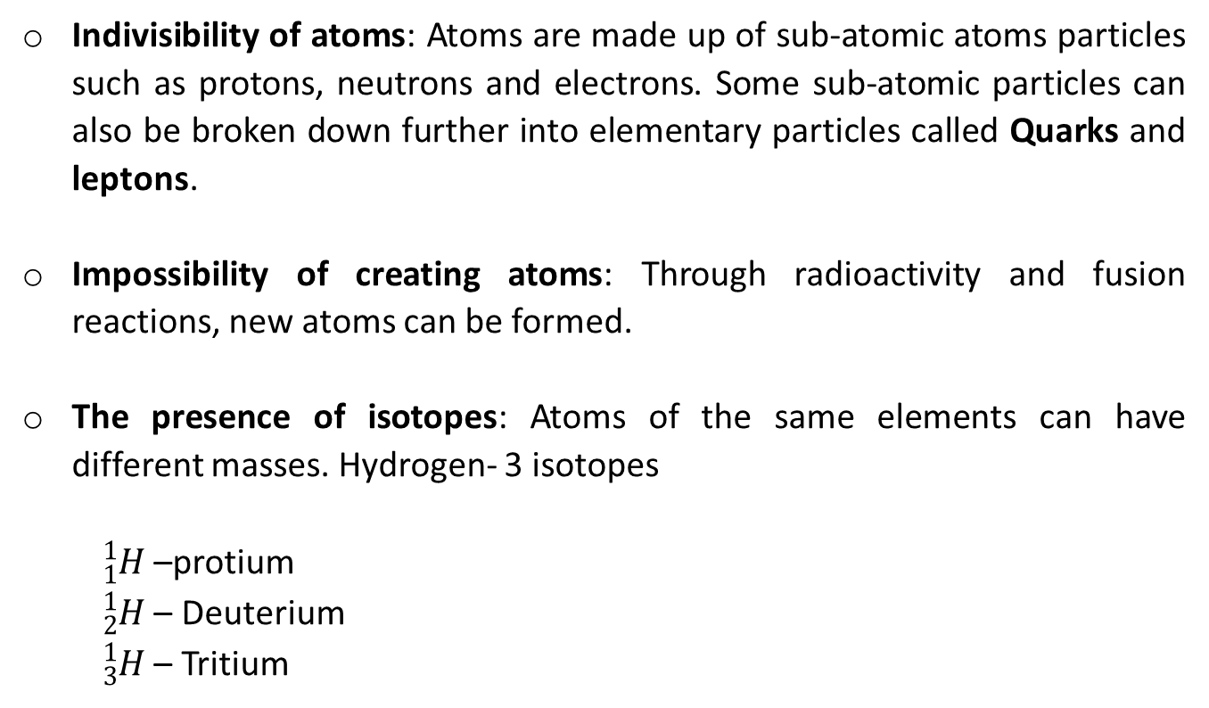
Incorrect aspect of the postulate
Indivisibility of atoms: Atoms are made up of sub-atomic atoms particles such as protons, neutrons and electrons. Some sub-atomic particles can also be broken down further into elementary particles called Quarks and leptons.
Impossibility of creating atoms: Through radioactivity and fusion reactions, new atoms can be formed.
The presence of isotopes: Atoms of the same elements can have different masses. Hydrogen- 3 isotopes
${}_{1}^{1}H$ –protium
${}_{2}^{1}H$ – Deuterium
${}_{3}^{1}H$ – Tritium

Slide 6
Models of atomic structure
Small indivisible hard ball models (J. Dalton)
A solid sphere of positive charge with the electrons structured uniformly in it. (Plum pudding or water melon) model – J.J. Thompson (read on cathode ray experiment)
A massive central nucleus with positive charge having electrons moving in orbit around the nucleus. (Nuclear atom model, Ernest Rutherford) Alpha scattering or Gold foil experiments.
Planetary model- Neil Bohr (Atomic spectrum)
Wave mechanic model- Schrondinger Erwin

Slide 7
Wave mechanistic model of the atom
Bohr’s atomic model could not account for the line spectra of elements bigger than hydrogen.
Louis de Broglie suggested that apart from electrons having a particulate nature, it can also have some wave properties.
He then formulated an equation which took account of this wave-particle dual nature of an electron.
Thus, taking electrons, they can have both momentum and wavelength.

Slide 8
Problem
For a sub-atomic particle, it would not be possible to know its position (wavelength) and momentum at the same time.
Postulations
The answer was in the “Uncertainty principle” which states that it is difficult to determine the position and momentum of an electron at the same time (this was by Werner Heisenberg).
Erwin Schrodinger combined de Broglie’s equation with other equations for wave motion to derive a new equation (Schrödinger equation) to describe the behaviour of an electron in a hydrogen atom.

Slide 9
The equation is very complicated for more than one electron.
The solutions of the equations are the wave functions, Psi (ψ).
The square of the wave function (ψ²) is a mathematical expression of the probability of finding an electron in a small volume that varies from place to place.
In atoms the wave function are called orbitals.
An orbital can be defined as a volume of space around the nucleus within which there is 95% probability of finding an electron.

Slide 10
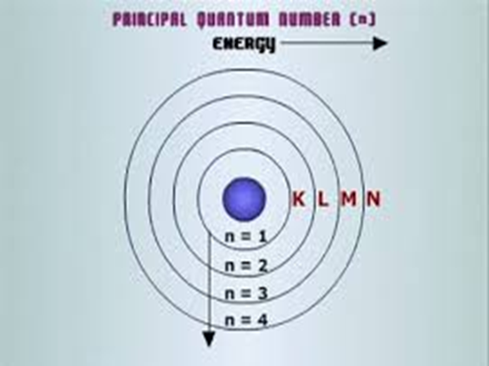
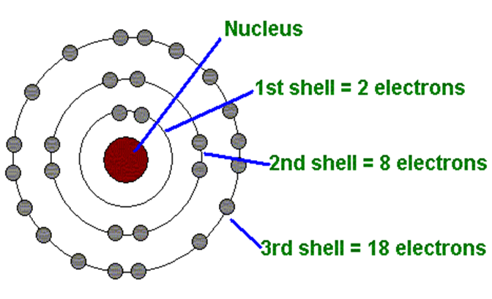
Quantum numbers
There are four quantum numbers;
Principal Quantum number (n): it determines energy level and closeness of electrons to nucleus. The integral values start from 1 to infinity. The naming starts from K, L, M….. The maximum number of electrons in “n” is given as 2n², where n= number of energy levels.
A shell is a collection of orbital with the same principal quantum number.

Slide 11
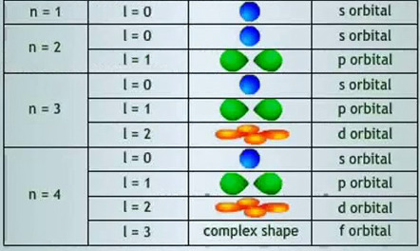
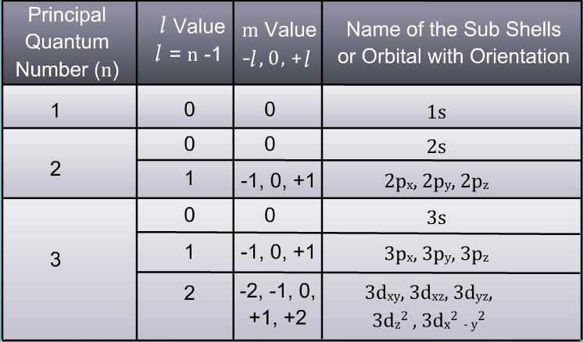
Orbital or Azimuthal quantum numbers (l): it defines the shape of an orbital. It starts from 0 to n-1.
Where n=1, l = 0 ≡ only one orbital or sub-shell called s-orbital which is symmetrically spherical and can contain two electrons.

Slide 12
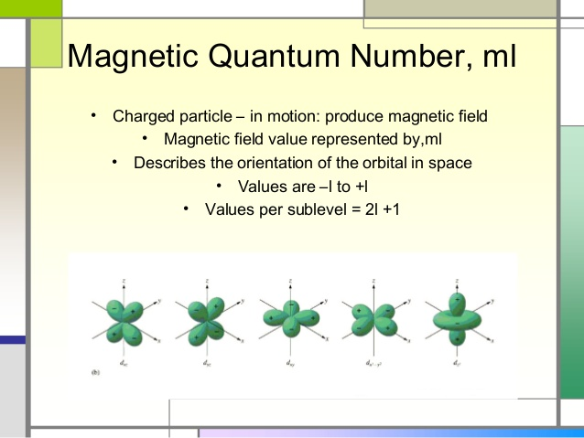
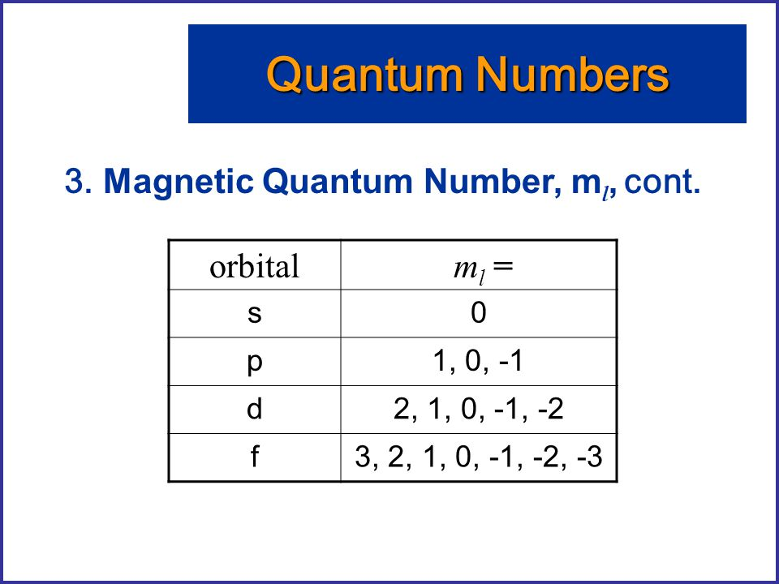
Magnetic quantum number (mi): it describes the orientation of orbitals in space. It starts from –l to +l including zero (0).
When n=1 l = 0, mi=0. In terms of orientation, the s-orbital has no direction of orientation.
When n=2, l= 0, 1 and mi= -1, 0, 1 this information is about the p-orbital.
When n= 3, l=0, 1, 2 mi= -2, -1, 0, +1, +2 (d-orbital)
When n=4 l=0,1, 2,3 mi= -3,-2,-1,0,+1,+2,+3 (f-orbital)

Slide 13
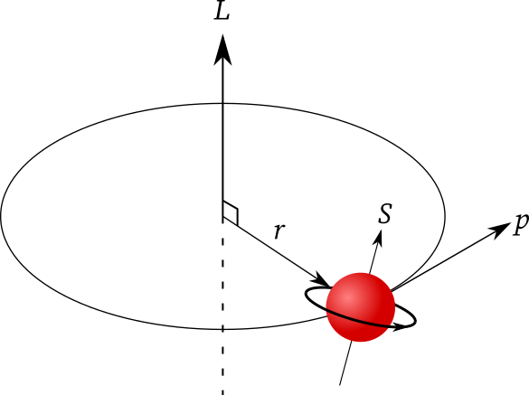
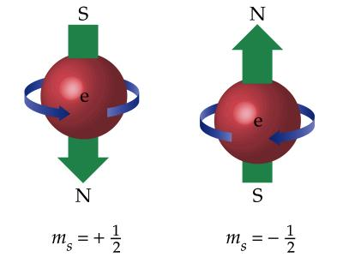
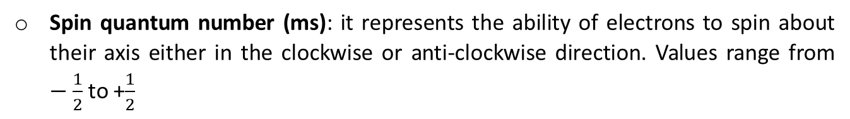
Spin quantum number (ms): it represents the ability of electrons to spin about their axis either in the clockwise or anti-clockwise direction. Values range from $−\frac{1}{2}$ to +$\frac{1}{2}$

Slide 14
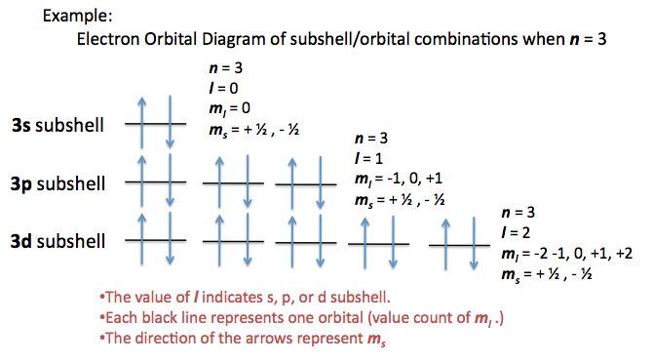
Example

Slide 15
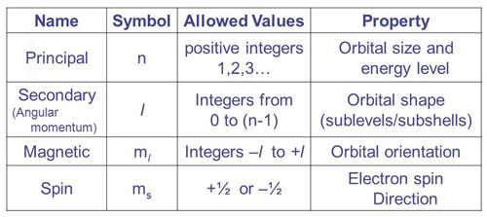
Summary

Slide 16
Electronic configuration
This refers to the arrangement of electrons in atoms. We have 2 approaches.
Electrons are arranged in shells taking into account only the principal quantum numbers.
Electrons are arranged in shells taking into account all the 4 quantum numbers.
The 2 approaches should adhere to the Aufbau’s rule which states that electrons’ energy level must be filled starting from the low energy level.
₁₁²³Na= 2, 8, 1 (1st approach) obeying the octet rule.
₁₁²³Na= 1s², 2s², 2p⁶, 3s¹ (2nd Approach)

Slide 17
1 | H | → | 1
2 | He | → | 2
3 | Li | → | 2 | 1
4 | Be | → | 2 | 2
5 | B | → | 2 | 3
6 | C | → | 2 | 4
7 | N | → | 2 | 5
8 | O | → | 2 | 6
9 | F | → | 2 | 7
10 | Ne | → | 2 | 8
11 | Na | → | 2 | 8 | 1
12 | Mg | → | 2 | 8 | 2
13 | Al | → | 2 | 8 | 3
14 | Si | → | 2 | 8 | 4
15 | P | → | 2 | 8 | 5
16 | Si | → | 2 | 8 | 6
17 | Cl | → | 2 | 8 | 7
18 | Ar | → | 2 | 8 | 8
19 | K | → | 2 | 8 | 8 | 1
20 | Ca | → | 2 | 8 | 8 | 2
21 | Sc | → | 2 | 8 | 9 | 2
22 | Ti | → | 2 | 8 | 10 | 2
23 | V | → | 2 | 8 | 11 | 2
24 | Cr | → | 2 | 8 | 13 | 1
25 | Mn | → | 2 | 8 | 13 | 2
26 | Fe | → | 2 | 8 | 14 | 2
27 | Co | → | 2 | 8 | 15 | 2
28 | Ni | → | 2 | 8 | 16 | 2
29 | Cu | → | 2 | 8 | 18 | 1
30 | Zn | → | 2 | 8 | 18 | 2
First Approach (Principal Quantum Numbers)

Slide 18
2ndApproach (All the 4 quantum numbers)

Slide 19
In the second approach, the atomic orbitals in the various shells are filled in this order: 1s, 2s, 2p, 3s, 3p, 4s, 3d, 4p, 5s, 4d, 5p, 6s, 4f, 5d, 6p, 7s etc…
Two other rules are considered.
Hund’s rule: for this rule, in filling degenerate orbitals, they are filled singly with electrons to the maximum before pairing up the electrons in the orbital.
Pauli’s exclusion principle: No two electrons in an orbital will have all the four quantum numbers being the same.

Slide 20
Sc=1s² | 2s² | 2p⁶ | 3s² | 3p⁶ | 3d¹ | 4s² | or | [Ar] | 3d¹ | 4s²
22 | Ti | → | [Ar] | 3d² | 4s²
23 | V | → | [Ar] | 3d³ | 4s²
24 | Cr | → | [Ar] | 3d⁵ | 4s¹
25 | Mn | → | [Ar] | 3d⁵ | 4s²
26 | Fe | → | [Ar] | 3d⁶ | 4s²
27 | Co | → | [Ar] | 3d⁷ | 4s²
28 | Ni | → | [Ar] | 3d⁸ | 4s²
29 | Cu | → | [Ar] | 3d¹⁰ | 4s¹
30 | Zn | → | [Ar] | 3d¹⁰ | 4s²
NB: stability in which the 3d and 4s are half filled

Slide 21
Relevant E-books

Slide 22
Question Time

Slide 23
Assignment One
Assignment on Google Forms (Link will be provided)
Submission deadline: 05/02/2021

Slide 24
Assignment One
Write the quantum numbers of the transition metals having the atomic
numbers from 39 to 48 using Ar as the core element.
N.B: The quantum numbers of Ar should be written for the initial step

